Slide 1
Steelbox Inc.
By Oliver H.,
Andrew Z., Cristopher M.

Slide 2
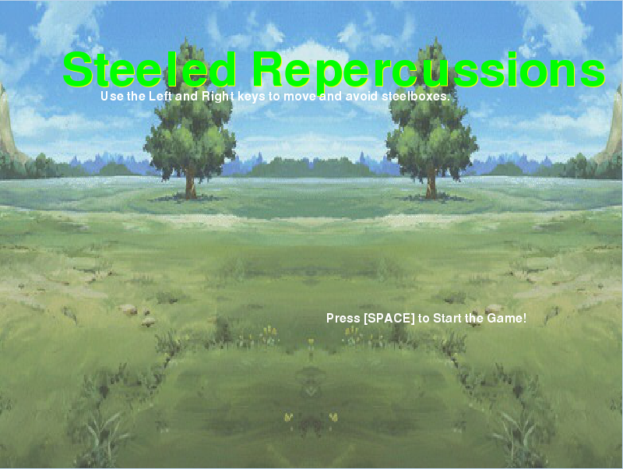
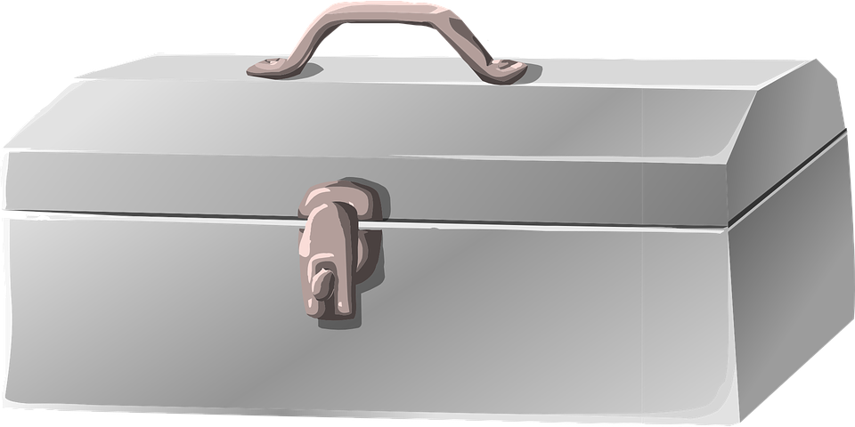
Steeled Repercussions
The game Steeled Repercussions is a game based on
Notes:
Steeled Repercussions, an ‘endless’ survival game, fitted to be similar to a bullet hell (..well, sort of). The objective is to survive the steelboxes that fall from the sky.
You use the keyboard to move around in the game.

Slide 3
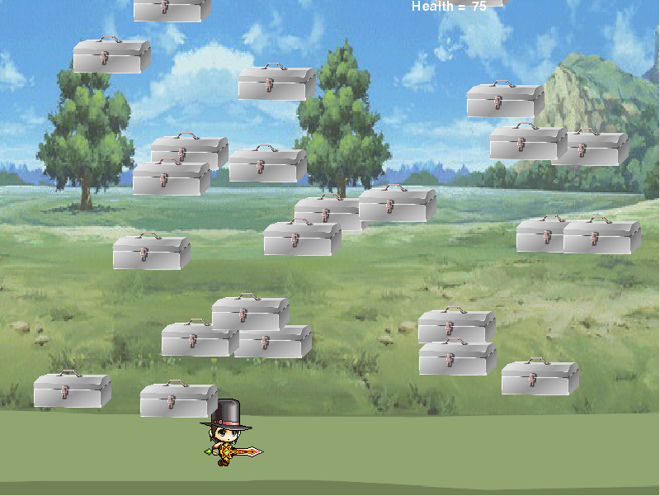

The Main Character
ANQ -
Mute, and generally mysterious.
The main, main.
Notes:
You play as ANQ, a mute and generally mysterious character. Using the left and right key to move, help ANQ survive as long as you can.
(generally there’s not much to do to be honest)

Slide 4
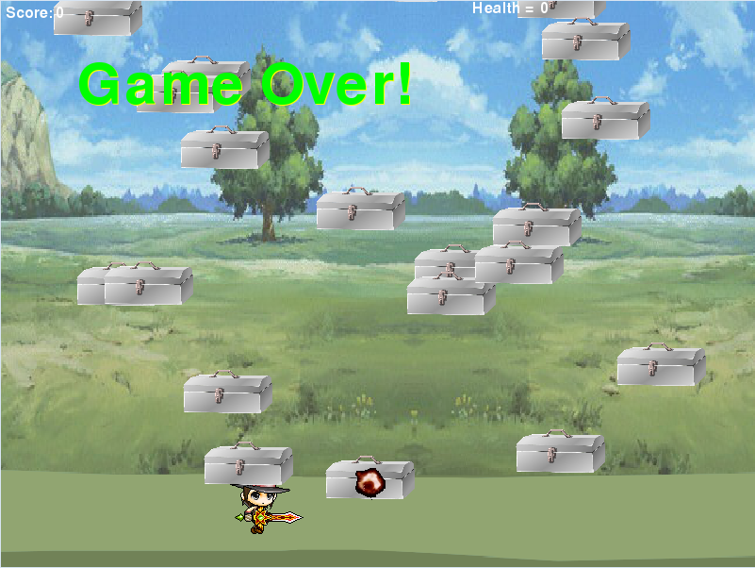
Notes:
If your health hits 0, you lose.
You don’t win, but you can try to win by surviving the steelboxes.
(why the hell is there no win objective)

